Slide 1


Status Report TTbar Angular Distributions NTUA
George Bakas

Slide 2
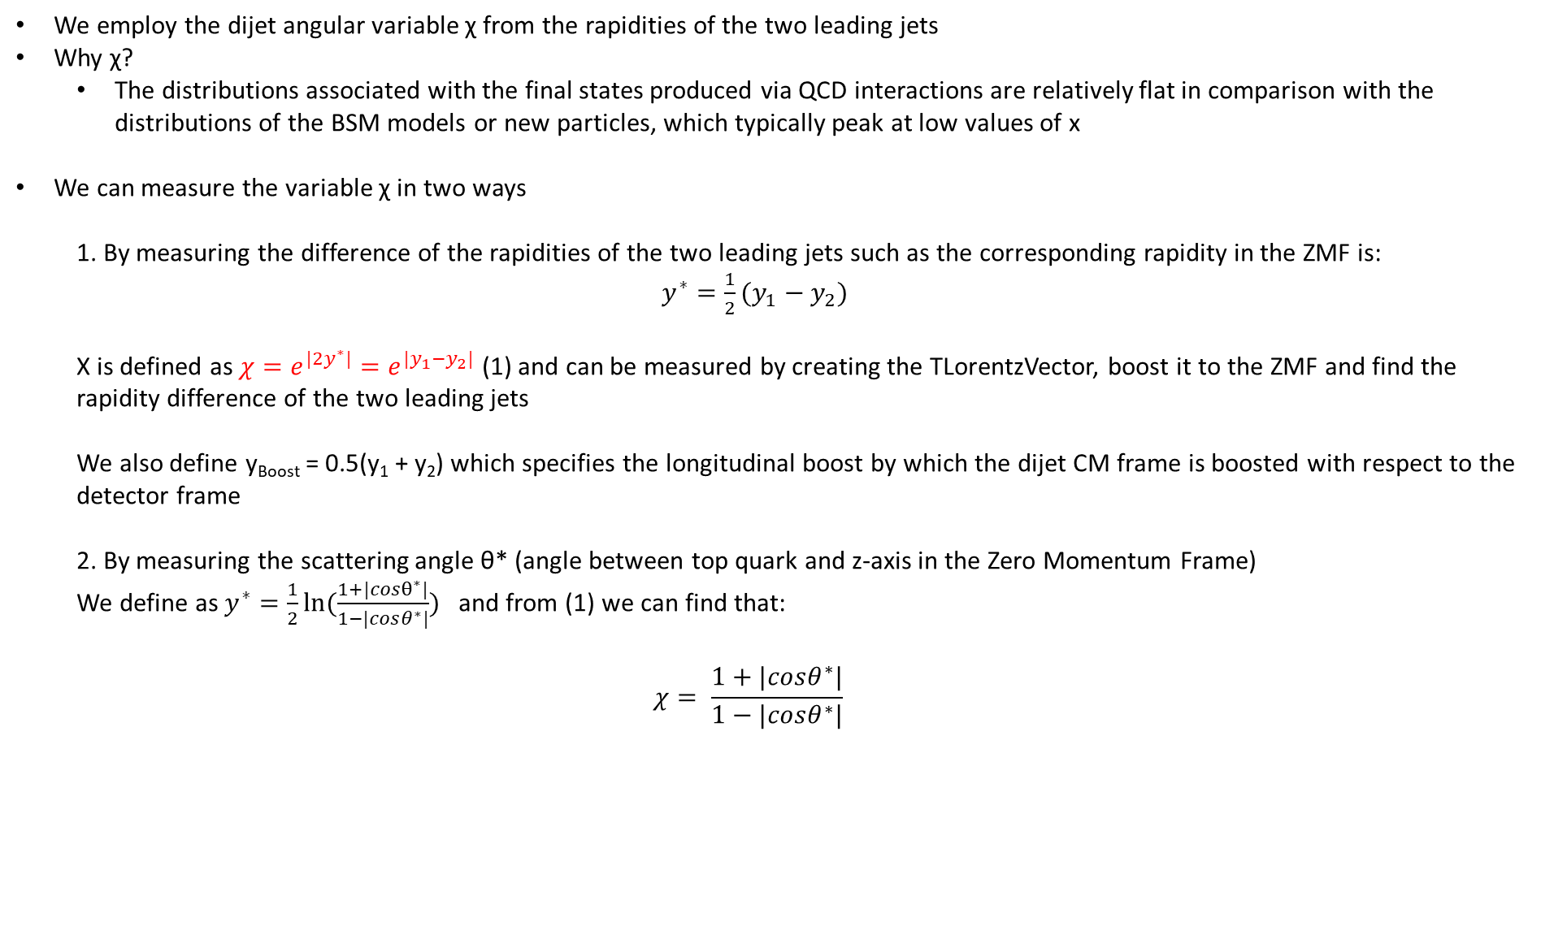
Variables
We employ the dijet angular variable χ from the rapidities of the two leading jets
Why χ?
The distributions associated with the final states produced via QCD interactions are relatively flat in comparison with the distributions of the BSM models or new particles, which typically peak at low values of x
We can measure the variable χ in two ways
1. By measuring the difference of the rapidities of the two leading jets such as the corresponding rapidity in the ZMF is: $y^{∗}=\frac{1}{2}(y_{1}−y_{2})$
Χ is defined as $χ=e^{{|2y}^{∗}|}=e^{|y_{1}−y_{2}|}$ (1) and can be measured by creating the TLorentzVector, boost it to the ZMF and find the rapidity difference of the two leading jets
We also define y_{Boost} = 0.5(y₁ + y₂) which specifies the longitudinal boost by which the dijet CM frame is boosted with respect to the detector frame
2. By measuring the scattering angle θ* (angle between top quark and z-axis in the Zero Momentum Frame)
We define as $y^{∗}=\frac{1}{2}ln⁡(\frac{1+|cosθ^{∗}|}{1−|cosθ^{∗}|})$ and from (1) we can find that:
$$χ= \frac{1+|cosθ^{∗}|}{1−|cosθ^{∗}|}$$

Slide 3
Response Matrices
Response matrix of χ_{reco}, χ_{parton} with {1,2,3,4,5,6,7,8,9,10,13,16} as variable binning
Response matrix of |cos(θ)|_{reco}, |cos(θ)|_{parton} 10 bins in [0,1] region
Stability, Efficiency for χ, |cos(θ)| distributions
Acceptance and purity for χ and |cos(θ)|distributions
Closure tests and TT contamination
I measure the χ using the exponential
Here you will find a comparison of 2016, 2017 and 2018 MC’s. (I only use the Mtt 1000-Inf file )

Slide 4

Response Matrices
Selection:
Jet Matching
Parton cuts:
partonPt[0],[1] > 400
|partonEta[0],[1]| < 2.4
mTTbarParton > 1000
Reco cuts:
nJets > 1
nLeptons = 0
mJJ > 1000
jetPt[0],[1] > 400
|jetEta[0],[1]| < 2.4
bTagging (Medium WP deepCSV)
Tagger cut(top Tagger> 0.1)
JetMassSoftDrop > 120 and < 220
Definitions:
$$Efficiency= \frac{\#events passing reco and parton cuts}{\#events passing parton cuts from EventCounter} \left(vs Parton\right)$$
$$Acceptance= \frac{\#events passing reco and parton cuts}{\#eventsing pass reco cuts }(vs Reco)$$

Slide 5
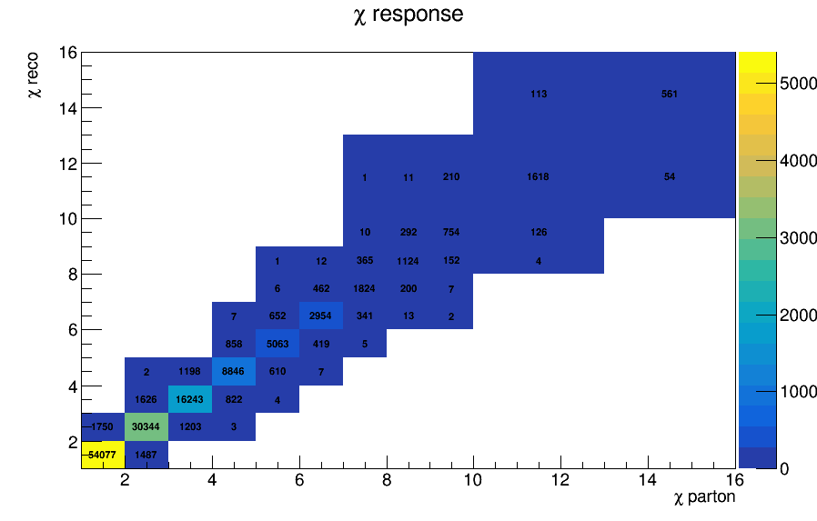
Response Matrix for χ 2016

Slide 6
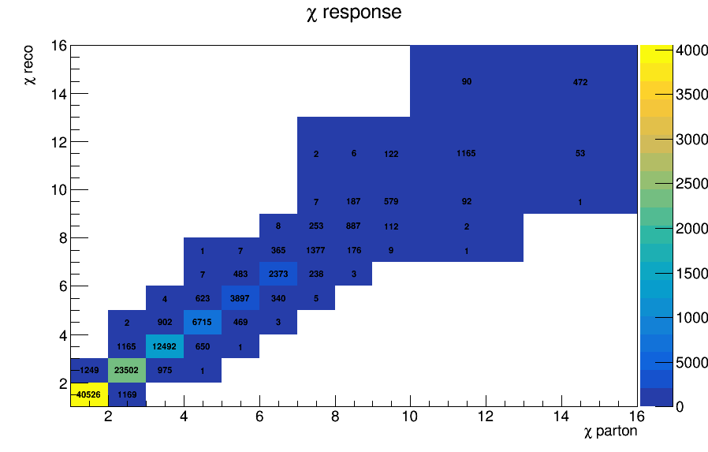
Response Matrix for χ 2017

Slide 7
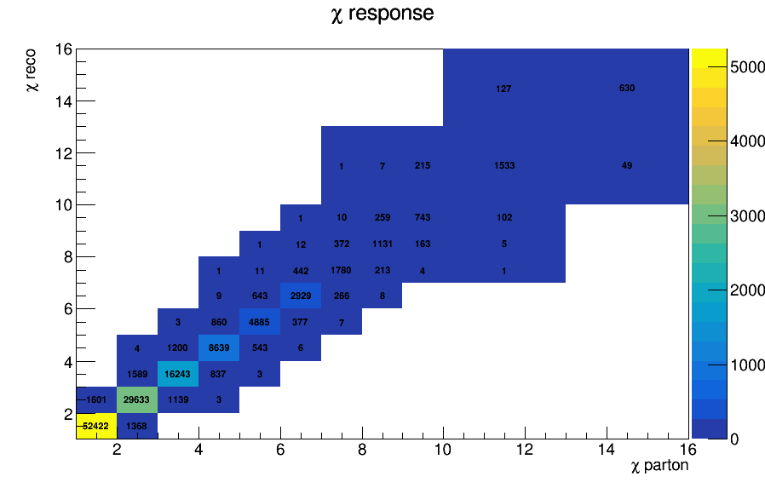
Response Matrix for χ 2018

Slide 8
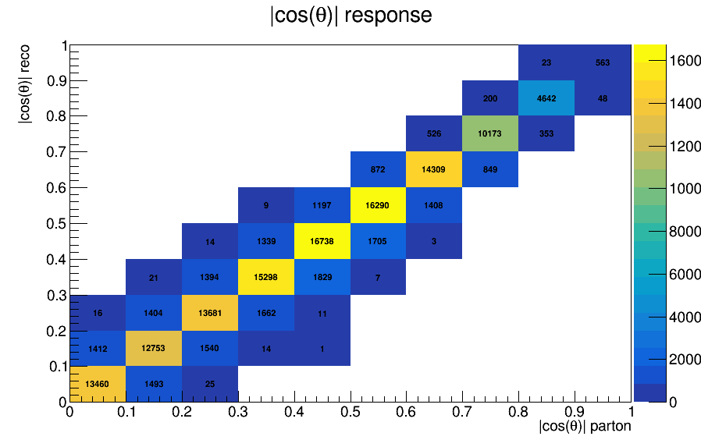
Response Matrix for |cos(θ)| 2016

Slide 9
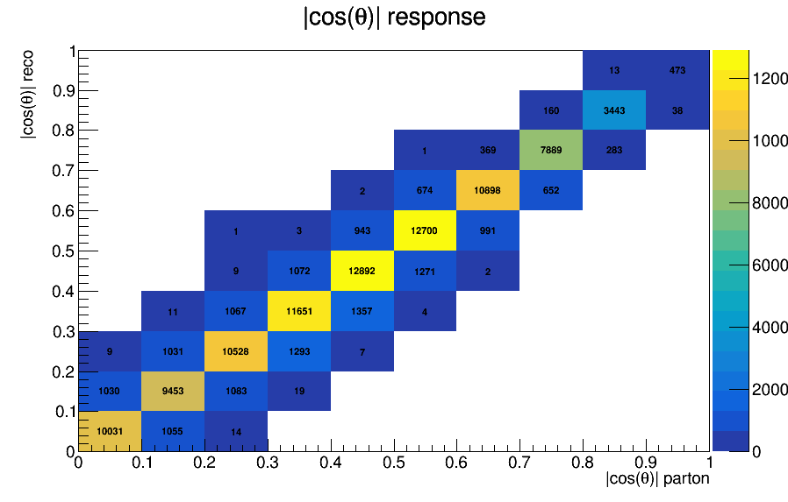
Response Matrix for |cos(θ)| 2017

Slide 10
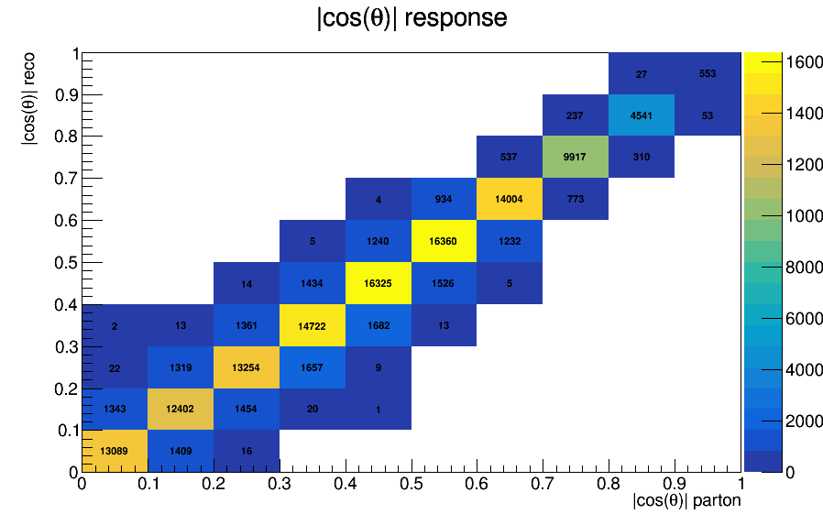
Response Matrix for |cos(θ)| 2018

Slide 11
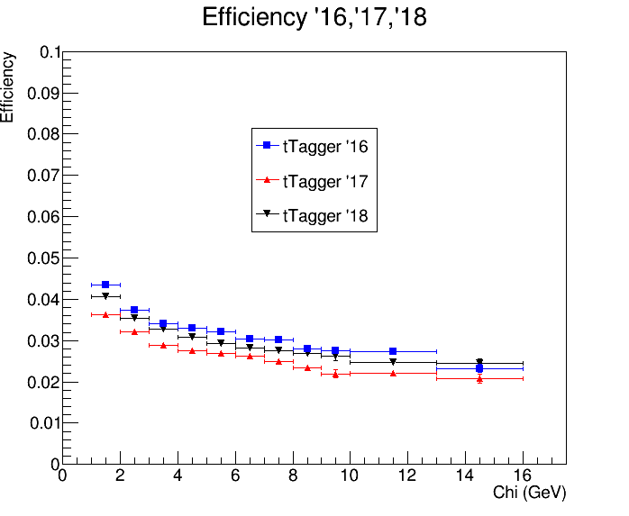
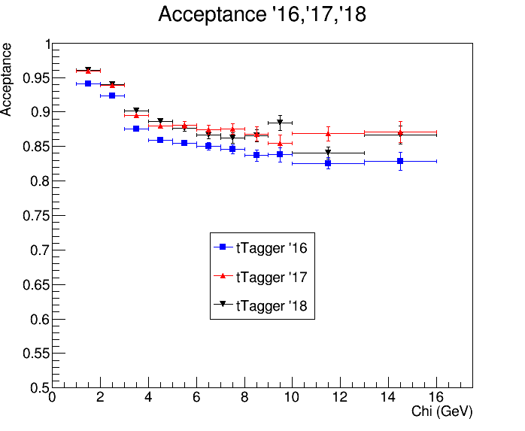
Efficiency and Acceptance for chi distribution 2016 vs 2017 vs 2018

Slide 12
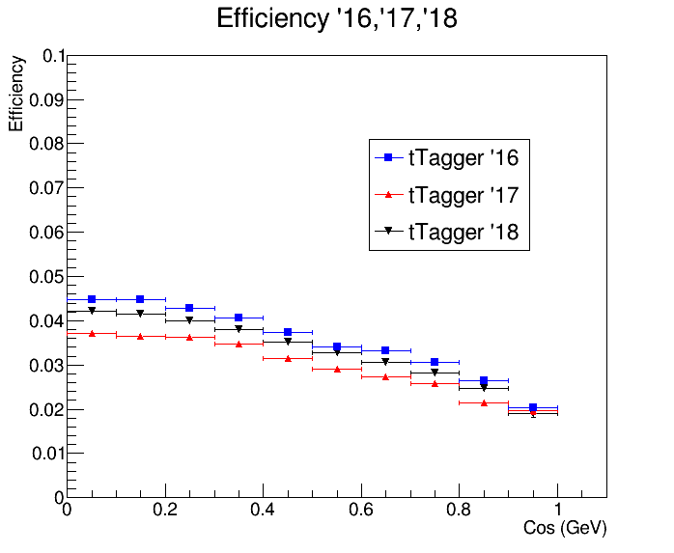
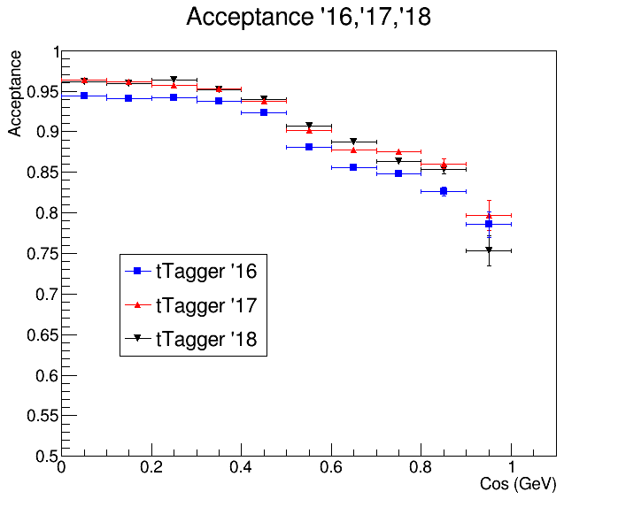


Efficiency and Acceptance for |cos(θ)| distribution 2016 vs 2017 vs 2018
$$|cos\left(θ^{∗}\right)|$$
$$|cos\left(θ^{∗}\right)|$$

Slide 13
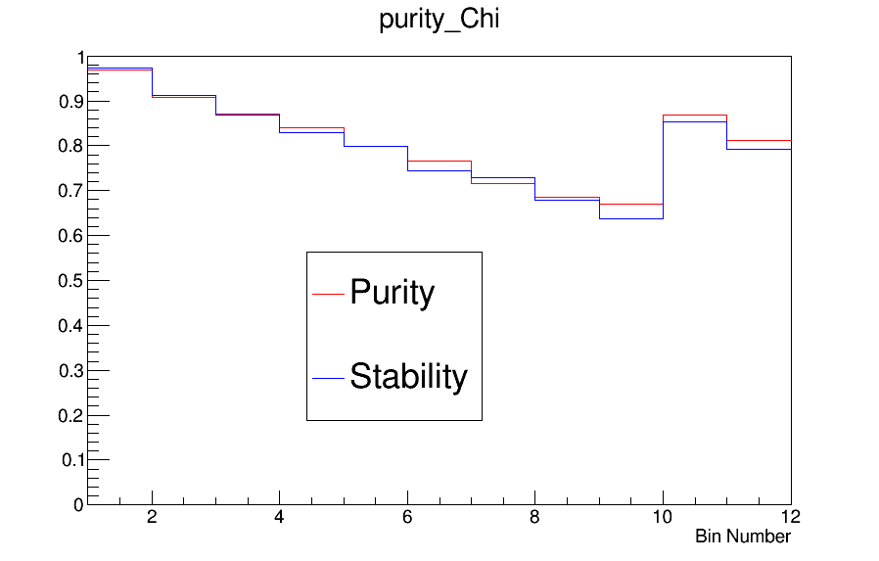
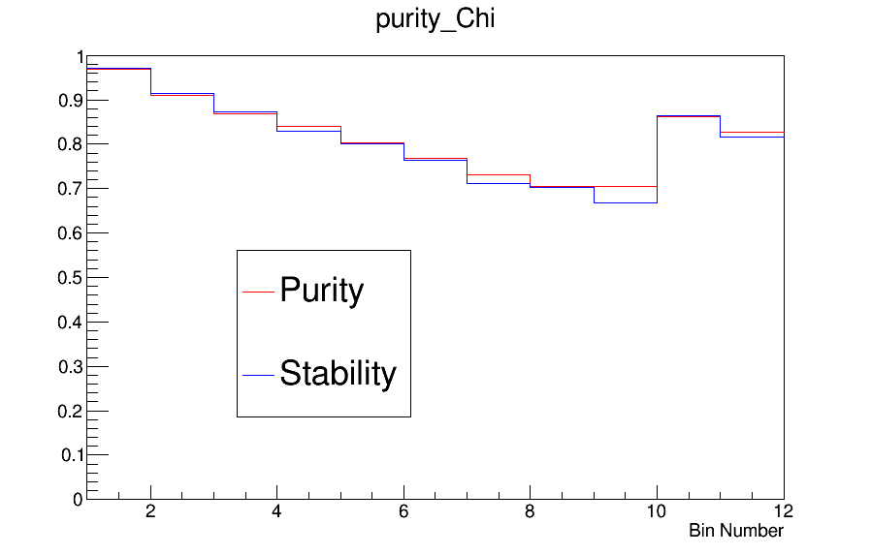
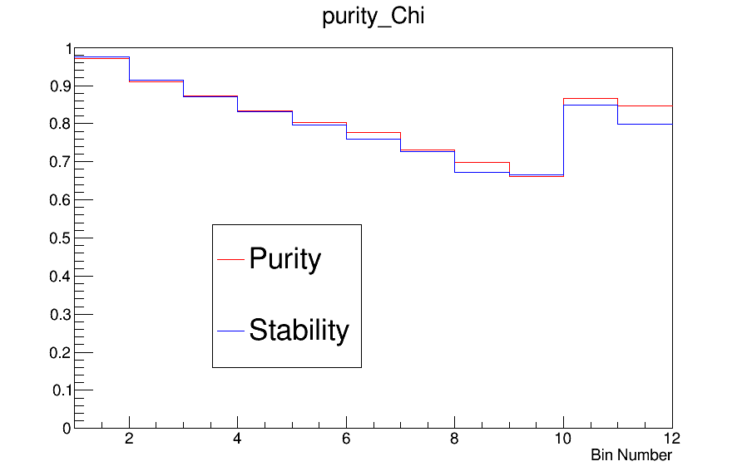
Purity and Stability for chi distribution
2016
2017
2018

Slide 14
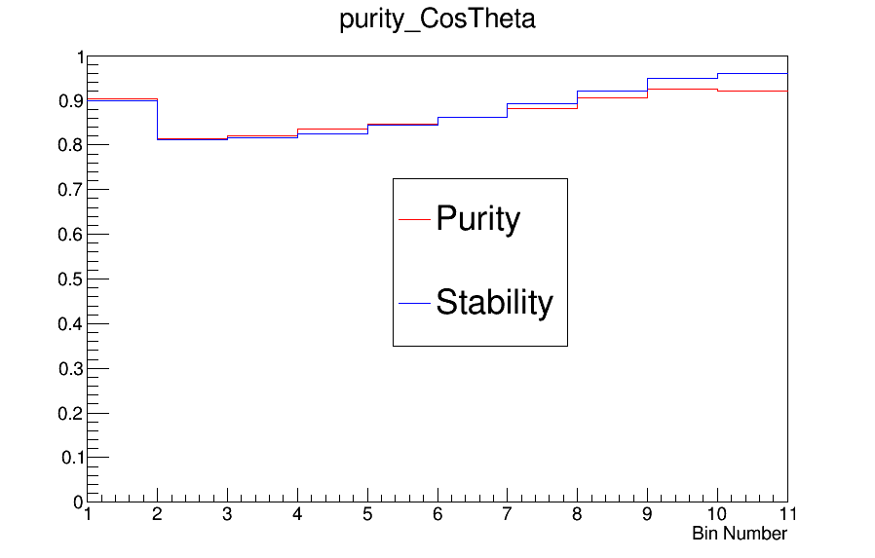
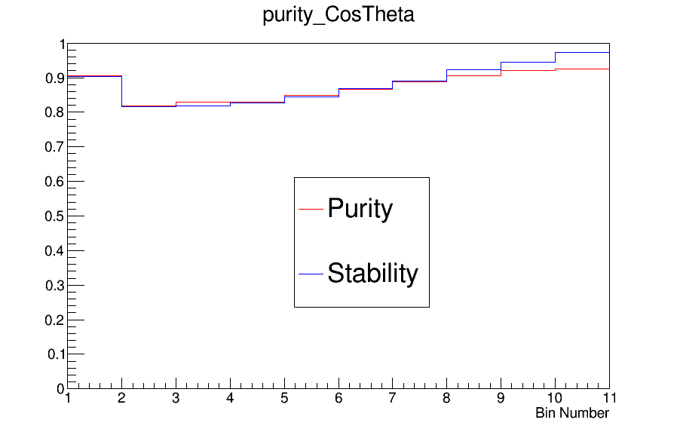
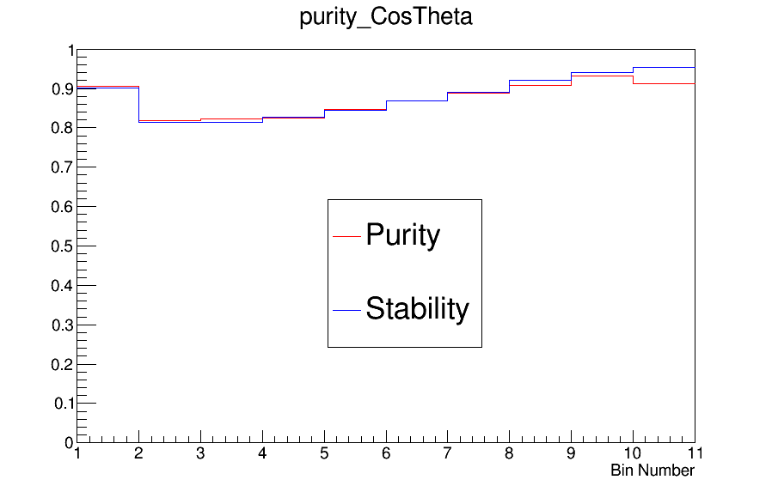
Purity and Stability for |cos(θ)| distribution
2016
2017
2018

Slide 15
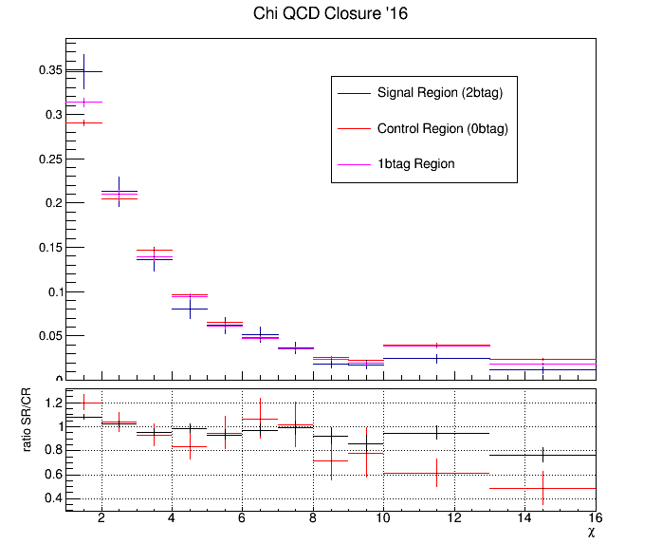
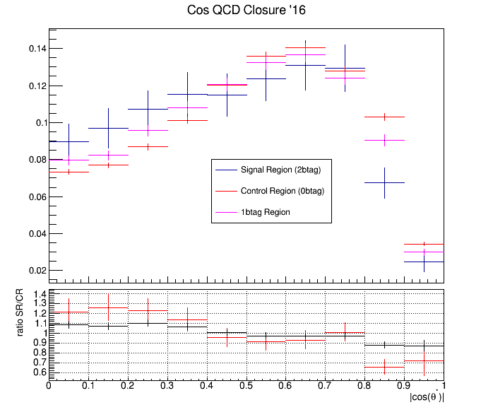
QCD Background MC closure tests 2016
Closure test for QCD samples in Control Region (SR but btagging is reverted (btag==0))

Slide 16
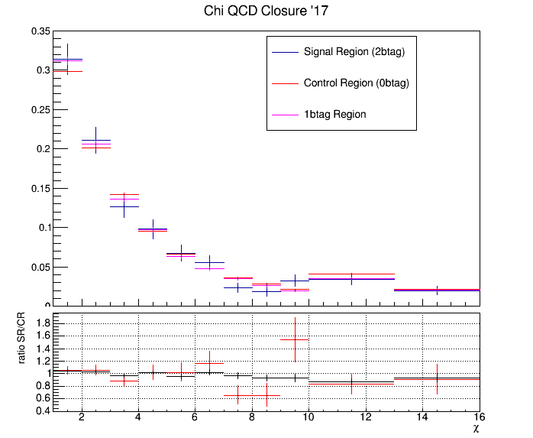
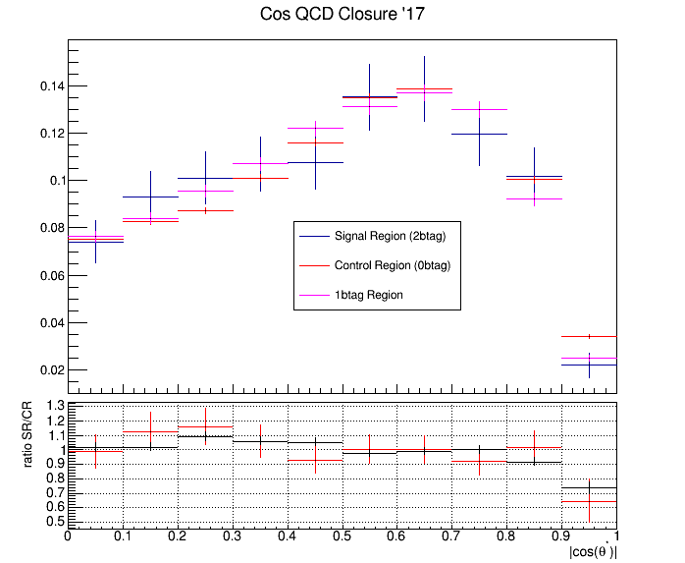
QCD Background MC closure tests 2017
Closure test for QCD samples in Control Region (SR but btagging is reverted (btag==0))

Slide 17
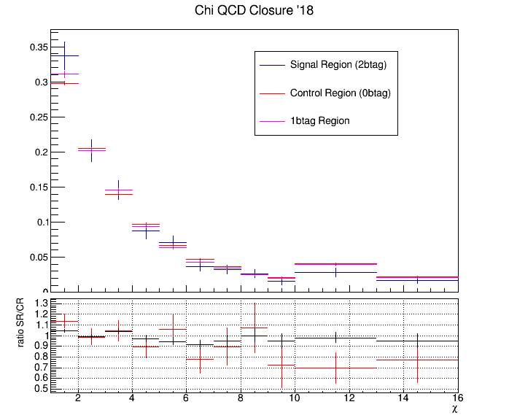
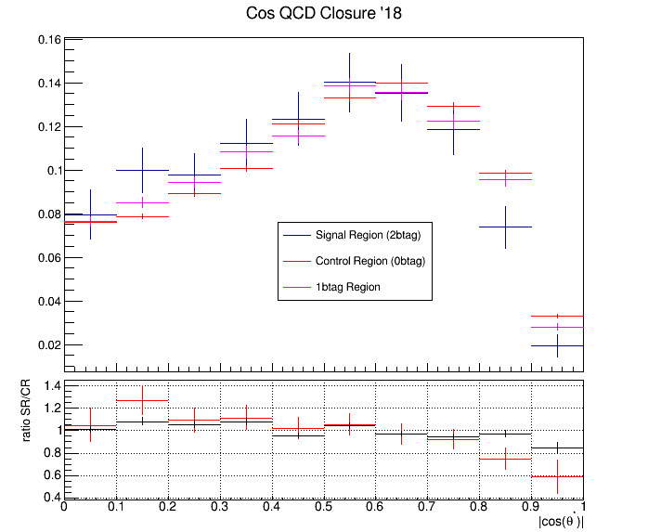
QCD Background MC closure tests 2018
Closure test for QCD samples in Control Region (SR but btagging is reverted (btag==0))

Slide 18
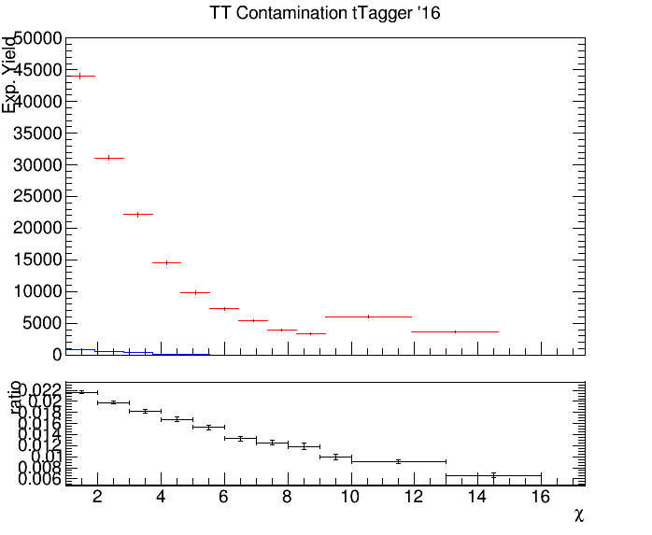
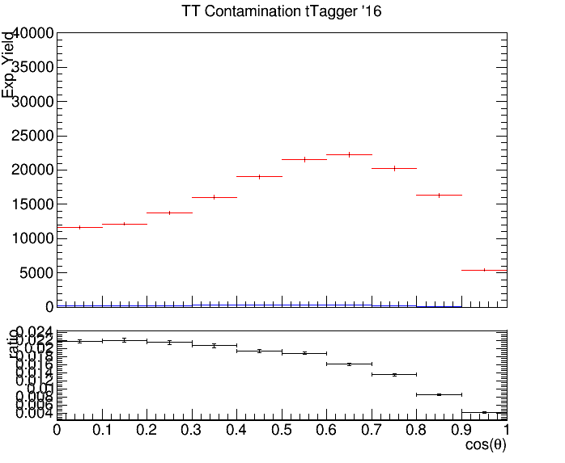

Control Region Contamination 2016
Expected yield from QCD Bkg samples and TT Signal sample in the CR
Control Region QCD sample
Control Region TT sample
Control Region QCD sample
Control Region TT sample
$$|cos\left(θ^{∗}\right)|$$

Slide 19
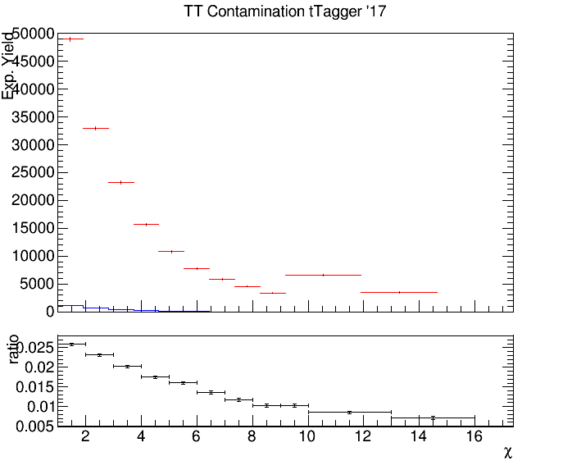
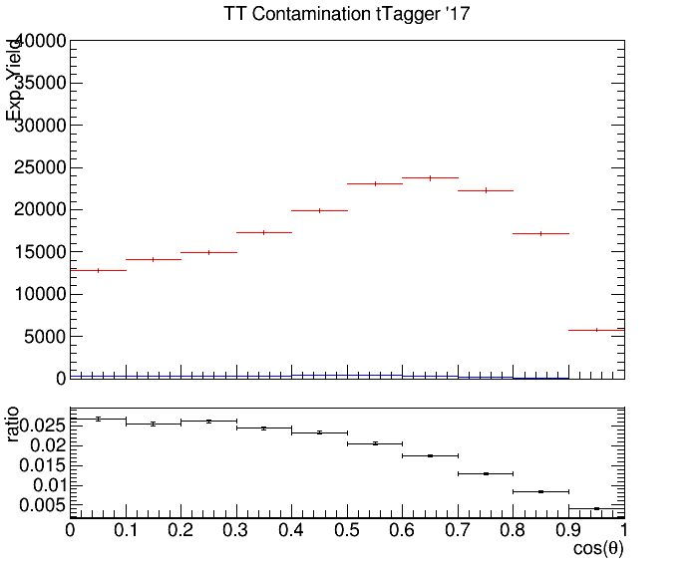

Control Region Contamination 2017
Expected yield from QCD Bkg samples and TT Signal sample in the CR
Control Region QCD sample
Control Region QCD sample
Control Region TT sample
Control Region TT sample
$$|cos\left(θ^{∗}\right)|$$

Slide 20
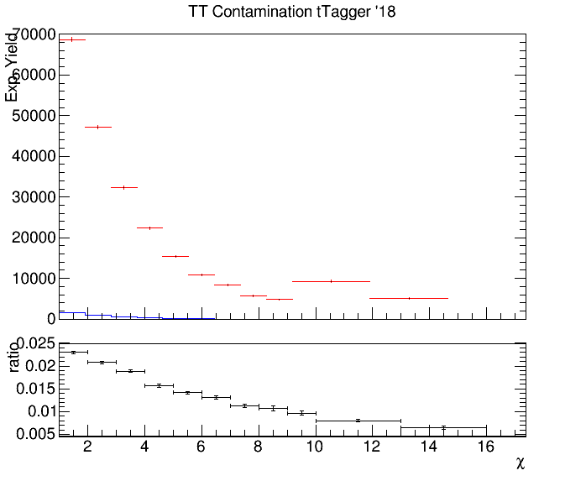
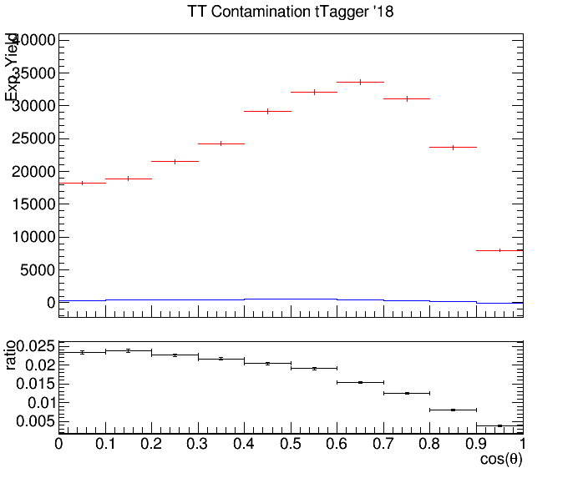

Control Region Contamination 2018
Expected yield from QCD Bkg samples and TT Signal sample in the CR
Control Region QCD sample
Control Region TT sample
Control Region QCD sample
Control Region TT sample
$$|cos\left(θ^{∗}\right)|$$

